Slide 1


OUR FRIENDLY SCHOOL

Slide 2
In our Friendly School
We care about each other
We take turns and share
We speak nicely to each other
We help each other
We listen to each other
We ask people to join in if they are alone

Slide 3
Unfriendly behaviour
Saying mean things about someone
Not letting someone join in
Teasing someone
or calling them names
Making someone feel scared or unhappy
Kicking, hitting or pushing someone

Slide 4
BULLYING is
Being mean on purpose again and again to someone, making them feel upset or afraid and not able to stop it from happening

Slide 5
Being UNFRIENDLY
Carelessly saying or doing something that hurts someone else
Being MEAN?
Being mean on purpose to someone, making them feel upset or hurt
BULLYING?
Being mean on purpose again and again to someone, making them feel upset or afraid and unable to stop it from happening

Slide 6
If you are bullied face to face:
Try to stay calm
Walk away
Ignore it
Say ‘stop’
Talk about it
If the bullying doesn’t stop find a teacher or adult and ask for help

Slide 9
Who can I talk to?
Miss Brown
Mum
School
Home
Mr White
Dad
Sport
Mrs Driver
Mr Coach
Bus

Slide 11
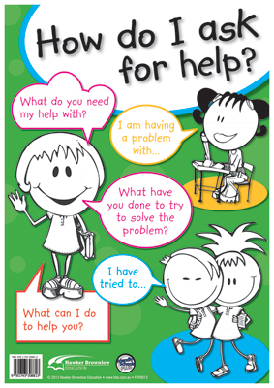
Teacher: Hello …. What do you need my help with?
Student:
I have a problem with…
I need help with…
I am feeling upset because…

Slide 12
Teacher: Have you tried to sort out the problem yourself?
Student: I have tried… but it is still happening
Student: I think I need some help to sort it out now please.
Teacher: That is fine.
Let’s go and I will help you sort this out
Teacher: Would you like me to suggested something else you could try of would you like me to help you sort it out?
Teacher: That is great. Let’s talk about what else you could try….
Student: I would like some more ideas to try to sort it out myself please.

Slide 13
The Teacher might suggest some actions for you to try:
Try asking the person why they are bothering you?
Stay calm and try to talk about the situation to find a solution with the person
Say “Just stop you are making this really hard for me and I have had enough”.
Do you think you could try one of these, or can you think of anything else you could try?
Teacher: If you don’t feel you can deal with it yourself or if your choice doesn’t work please come straight back to me and I will help you sort this out.

Slide 15
Start by saying:
I feel… (Say how you feel):
I feel … annoyed, upset, scared, angry, embarrassed… (you may with to go through some words to describe feelings for this section)
When you… (Say why you feel that way)
When you … tease me, leave me out, talk to me like that, won’t let me have a turn…
Because … (Say how why this is making you feel this way.)
It hurts my feelings, I feel alone, It makes me upset…
And what I want …
(Say what you would like to happen to make things better)
I would like you to stop teasing me
I would like to play without being annoyed.
I would like to be able to play - with the group/other children/in the game

Slide 16
Put it all together
I feel really sad
When you don’t let me join in the game
Because I don’t want to be left out
I just want to be able to play too

Slide 17
Put it all together
I feel upset
When you say mean things to me
It really hurts my feelings when you tease me
I would like you to stop teasing me and making me feel upset

Slide 18
If you see someone is being upset, hurt or left out you could:
Go and talk to a teacher to get help
Ask them if they are okay
Ask them if you can help them
Tell them to go to a teacher for help
Ask them to come and sit with you and your friends

